Slide 1
Test-Driven Development In Action
20/01/2025

Slide 2
Workshop Contents
What is TDD?
Effects and Properties of Testable Code
Why TDD?
Red > Green > Refactor
TDD and CI/CD
TDD Pitfalls
Testing Terminology
TDD Java Tools
TDD In Practice

Slide 3
What is TDD?
Like accountant’s double bookkeeping, TDD verifies our codes match our intent
Express intent in the form of a test
Test the test making sure it fail
Create minimum code to see the test pass
Refactor the code, keeping the test pass
More powerful than simple unit testing
Design through testing
Drive development from tests
Check that the code works
Notes:
Unit testing is about testing
TDD is about design

Slide 4
Effects and Properties of Testable Code
Effects of high-quality code
Easy to read
Testable
Ease to change
Simplicity
Efficiency
Properties of good code
Modular
Loosely coupled
Cohesion
Separation of concerns
Encapsulation

Slide 5
Why TDD?
Computer code is abstract and fragile
Humans are very good at making mistakes
58% of critical system failures are due to simple programming mistakes that could be avoided if any testing existed
Test-driven development can reduce production bugs by up to 90%
Makes a good programmer better and a bad one… less bad
Helps the programmer write well-designed high-quality code
Dramatically increases long-term project maintainability

Slide 6
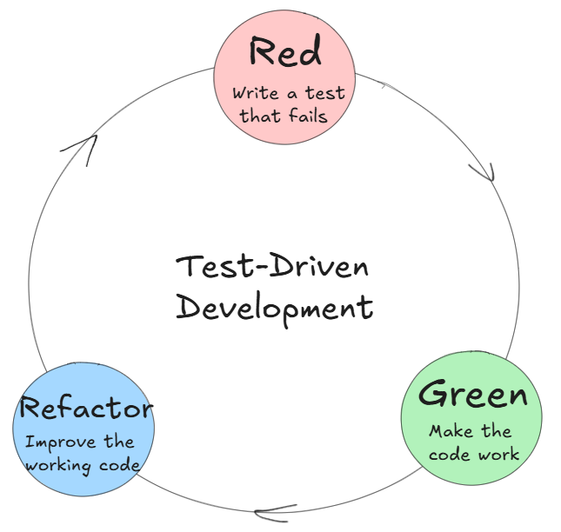
Red > Green > Refactor
The tri-color TDD hat:
Design – focus on design and testability
Implement – focus on validity
Improve – focus on quality
Test your test by imagining different implementations. This should be easy!
Notes:
Design – external view
Implement – shortest way to reach stable state
Improve – focus on internal implementation

Slide 7
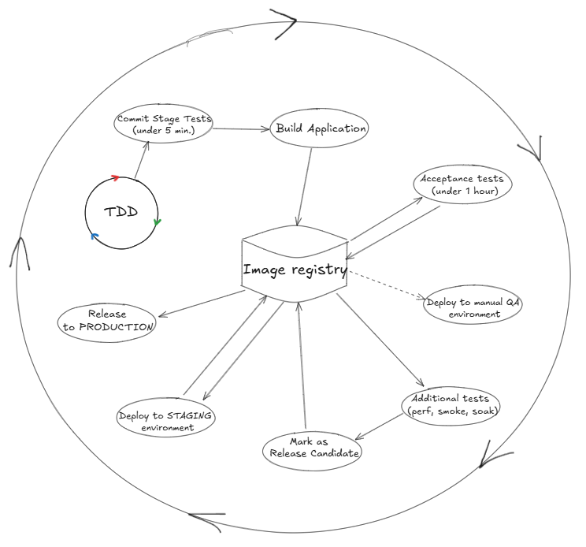
TDD and CI/CD
CI/CD Pipeline stages
Commit stage (<5 min)
Acceptance stage (<60 min)
Release stage
Test-Driven Development
Promotes small, iterative improvements
Provides fast feedback for the commit stage
About 80% confidence of code releasability

Slide 8
TDD Pitfalls
Chasing test coverage before all
Writing tests to pass instead of fail first
Reducing number of tests to optimize test maintenance
Big tests that test too much
Tests that test stuff that has already been tested
Not testing at the edges (I/O, UI etc.)
Testing 3rd party code
Mocking 3rd party code
Bad test names
Unreliable tests that give false confidence
Overly complex test setup
Retrofitting TDD to legacy code
Tests that test the implementation instead of the results
Notes:
TDD does not feel very natural in the beginning.
Try to prove your code does not work instead of the opposite
Start tests with “should”
Complex test setup is a clear sign of bad code design

Slide 9
TDD Pitfalls… and how to avoid them
Test if the code does what it should do from user point of view
Is the design of the code under test good?
Use abstractions to minimize code difficult to test (I/O) and strategically use integration tests
Apply TDD only to new code
Apply continuous integration
Hone your refactoring skills
Use TDD to drive the development and asses the code quality
Notes:
TDD does not feel very natural in the beginning.
Try to prove your code does not work instead of the opposite
Start tests with “should”
Complex test setup is a clear sign of bad code design

Slide 10
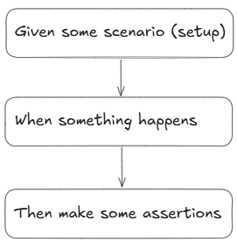
Common Testing Terminology
Test Scenario
Express a business case with domain terminology
Set up some starting conditions (given)
Executes some business action (when)
Verifies the result’s correctness (then)

Slide 11
Testing Terminology: Fake
A copy of a class object with limited functionalities is called a fake. For example, a fake user repository returning expected set of users.
public interface UserRepository { String[] getUsernames(); }
Real implementation
Fake implementation
public class UserRepositoryImpl implements UserRepository { @Override public String[] getUsernames() { return database.getUsernames(); } }
public class FakeUserRepository implements UserRepository { @Override public String[] getUsernames() { return new String[]{"test_user"}; } }

Slide 12
Testing Terminology: Mock
An object representing reality with limited functionality that we can manipulate to behave in certain way under certain conditions is a mock.
Using mocks allows us to assert interactions with the mock.
Stub is a lightweight version of a mock that does not record interactions or return different values. Usually, the term is used interchangeably with “mock”.
public interface UserRepository { String[] getUsernames(); }
@Mock UserRepository userRepository; @Test void testCase(){ when(userRepository.getUsernames())
.thenReturn(new String[]{"test_user"});
verify(userRepository).getUsernames(); }

Slide 13
Testing Terminology: Spy
A spy tracks every interaction with a real object allowing us to check it at a later point.
@Spy List<String> spyList = new ArrayList<String>(); @Test void shouldSpyOnList() { spyList.add("one"); verify(spyList).add("one"); }

Slide 14
Testing Terminology: Argument Captor
An argument captor allows us to capture an argument passed to a method so we can inspect it.
public class UserRepositoryImpl implements UserRepository { private final Database database; public UserRepositoryImpl(Database database) { this.database = database; } @Override public void saveUser(String username) { database.saveUser(username); } }
@ExtendWith(MockitoExtension.class) class UserRepositoryImplTest { @Mock Database database; @InjectMocks UserRepositoryImpl userRepository; @Captor ArgumentCaptor<String> usernameCaptor; @Test void shouldSpyOnList() { userRepository.saveUser("test_user"); verify(database).saveUser(usernameCaptor.capture()); var username = usernameCaptor.getValue(); assertEquals("test_user", username); } }

Slide 15
TDD Java Tools
Testing frameworks:
JUnit
Spock
TestNG
Mocking frameworks
Mockito
PowerMock
EasyMock
Assertion libraries
AssertJ
Hamcrest
Integration testing
Spring Test
Testcontainers
WireMock
RestAssured

Slide 16
TDD In Practice
Download project from https://github.com/G2HJei/tdd-workshop
Includes
Mockito & JUnit 5
Coding kata
This presentation
The goal is to complete the coding kata using TDD principles

Slide 17
TDD Coding Kata: Haiku
Haiku is an ancient form of Japanese poetry. A haiku is a three-line poem with seventeen syllables, where the first and third lines must contain 5 syllables each, while the second line must contain 7. The lines do not have to rhyme. For example:
Write a program that will review a haiku and check that each line contains the correct number of syllables.
The input string has at least one row. Each row is a single haiku with exactly 2 slashes separating the haiku lines.
A haiku will contain only lowercase ‘a’-’z’ letters, forward slashes and spaces.
A syllable is every continuous sequence of one or more vowels, where the vowels are ‘a’, ‘e’, ‘I’, ‘o’, ‘u’ and ‘y’. Every word will contain at least one syllable.
For each haiku output a comma-separated single line that contains the number of syllables in each haiku, together with the letter ‘Y’ if the row is a haiku or ‘N’ if it is not a haiku. For example:
computer programs/bugs try to eat my code/i must not let them
INPUT
happy purple frog/eating bugs in the marshes/get indigestion
computer programs/the bugs try to eat my code/i will not let them
OUTPUT
5,7,5,Y
5,8,5,N

Slide 18
TDD Coding Kata: Birthday Emails 1/2
Write a program that
Loads a set of employee records from a flat file
Sends a greetings email to all employees whose birthday is today
The flat file is a sequence of records, separated by newlines; this are the first few lines:
The greetings email contains the following text:
with the first name of the employee substituted for “John”.
People born on a 29th of February should be sent greetings on the 28th of February, except in leap years, when they will get their greetings on the 29th.
last_name, first_name, date_of_birth, email
Doe, John, 1982/10/08, john.doe@foobar.com
Ann, Mary, 1975/09/11, mary.ann@mail.co.uk
Subject: Happy birthday!
Happy birthday, dear John!

Slide 19
TDD Coding Kata: Birthday Emails 2/2
Tips
The program should be invoked by a main program like this one:
Note that the collaborators of the birthdayService objects are injected in it.
Goals
The goal of this exercise is to produce a solution that is
Testable; we should be able to test the internal application logic with no need to ever send a real email.
Flexible: we anticipate that the data source in the future could change from a flat file to a relational database, or perhaps a web service. We also anticipate that the email service could soon be replaced with a service that sends greetings through Facebook or some other social network.
Well-designed: separate clearly the business logic from the infrastructure.
public static void main(String[] args) {
...
var birthdayService = new BirthdayService(employeeRepository, emailService);
birthdayService.sendGreetings(today());
}

Slide 20
Additional Resources
Continuous Delivery Youtube Channel – TDD and CI/CD
Cyber Dojo – Online platform for TDD practice
“Modern Software Engineering: Doing What Works to Build Better Software Faster”,Dave Farley
“Test Driven Development: By Example”, Kent Beck
Mockito Series @ baeldung.com

